Slide 1
RVMS
A practical reactive architecture for Flutter
Thomas Burkhart
@thomasburkhartb

Slide 2
Why another architecture?
Most existing architectures like MVP/MVVM don‘t match the reactive View updating of Flutter.
All current State Management solutions address only a small aspect but don’t give guidance on the architecture of the whole App.
MVU describes Flutter quite well but is only an abstract concept.

Slide 3
Goals of R(x)VMS
Easy to explore and to understand
No configuration by convention (violates 1)
Avoiding black magic of a framework (violates 1)
Encourage the feeling of work ownership when working on a team
Clear separation of concerns
Easy to test
Able to scale
Minimal boring boilerplate code
Not too rigid to be flexible
Fun to work with
Highly Reactive
Notes:
5 let the Widgets rule not some central state machine

Slide 4
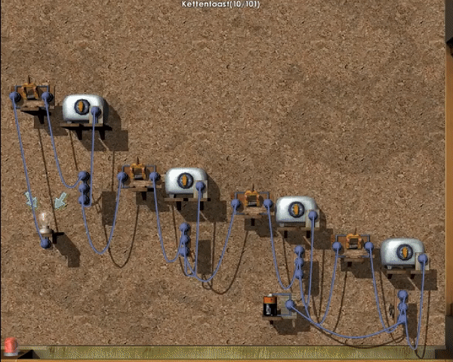

Slide 5
Interactions inside an RVMS App
Invoice Detail View
Invoice Manager
Database Service
Login View
**
Authentication Service
User Manager
Map View
Location Service
ValueListenables
(async) function calls
or Streams
** Can be (async) function calls or ValueListenables or Commands. But should be limited as much as possible to avoid unnecessary coupling.
Comands
or
method calls

Slide 6
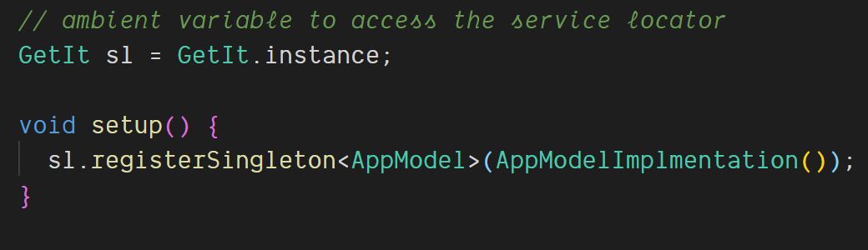
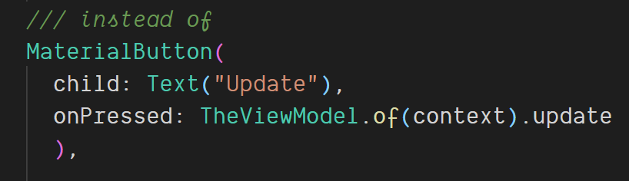
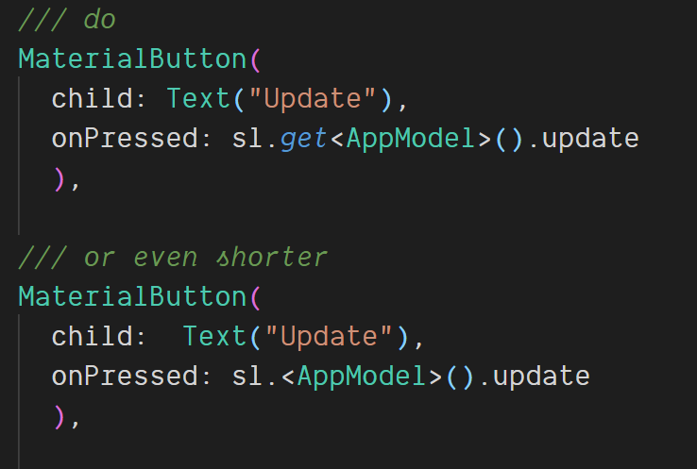
Building blocks: ServiceLocator GetIt
Notes:
Allows the access to registered objects from anywhere in the App
Objects can be registered with their super type so that the concrete implementation can be exchanged any time.

Slide 7
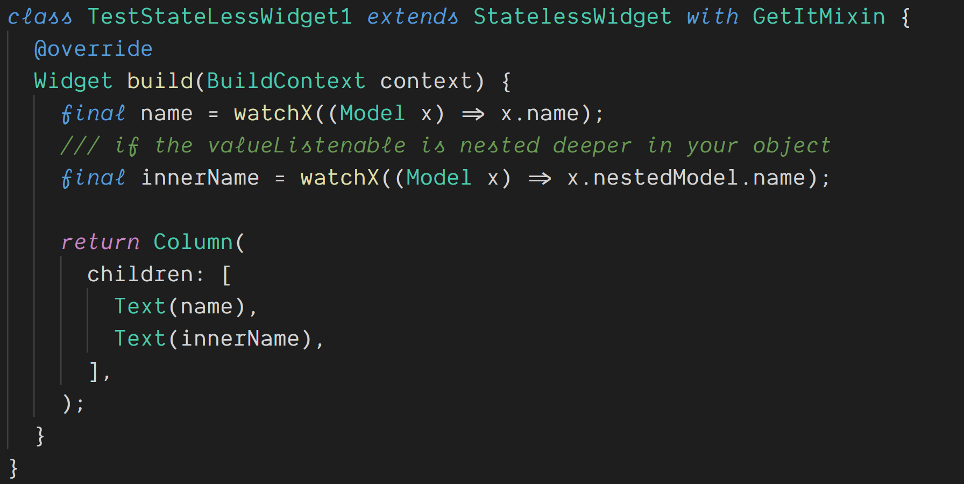
Everything gets easier with GetMixin
Notes:
Allows the access to registered objects from anywhere in the App
Objects can be registered with their super type so that the concrete implementation can be exchanged any time.

Slide 8
Building blocks: Commands
Wraps a sync/async function that is executed by calling .execute(value)
Is an ValueNotifier<TResult> itself
Is a callable class, so you can assign it directly: onTextChanged: myManager.onSearchChangedCommand,
Command<TParam,TResult>
.execute(TParam)
TResult
ValueNotifier<type>
Notes:
If you love Streams there is also a package called rx_command

Slide 9
Building blocks: Commands
Busy state & Error Handling
Command<TParam,TResult>
.execute(TParam)
TResult
isExecuting true / false
thrownExceptions: Exception
ValueNotifier<type>
Notes:
If you love Streams there is also a package called rx_command

Slide 10
Building blocks: Commands
results property offers all state information in one Object
Command<TParam,TResult>
.execute(TParam)
TResult
results CommandResult<TResult>
isExecuting true / false
thrownExceptions: Exception
ValueNotifier<type>
Notes:
If you love Streams there is also a package called rx_command

Slide 11
Building blocks: Commands
canExecute = isExecuting && restriction
Command<TParam,TResult>
.execute(TParam)
TResult
results CommandResult<TResult>
restriction true / false
canExecute true / false
isExecuting true / false
thrownExceptions: Exception
ValueNotifier<type>
Notes:
If you love Streams there is also a package called rx_command

Slide 12
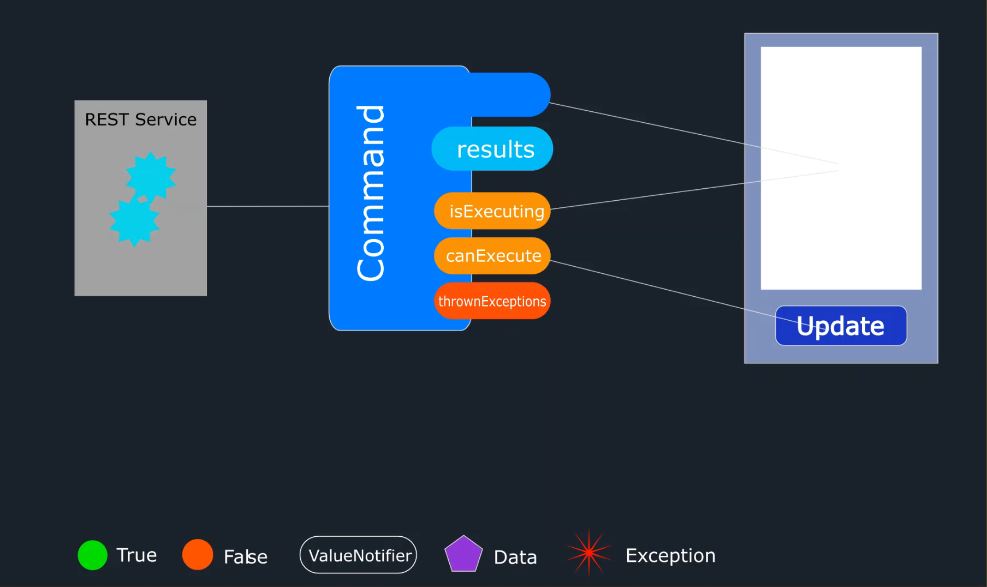
A command in motion

Slide 13
Let‘s see some code

Slide 14
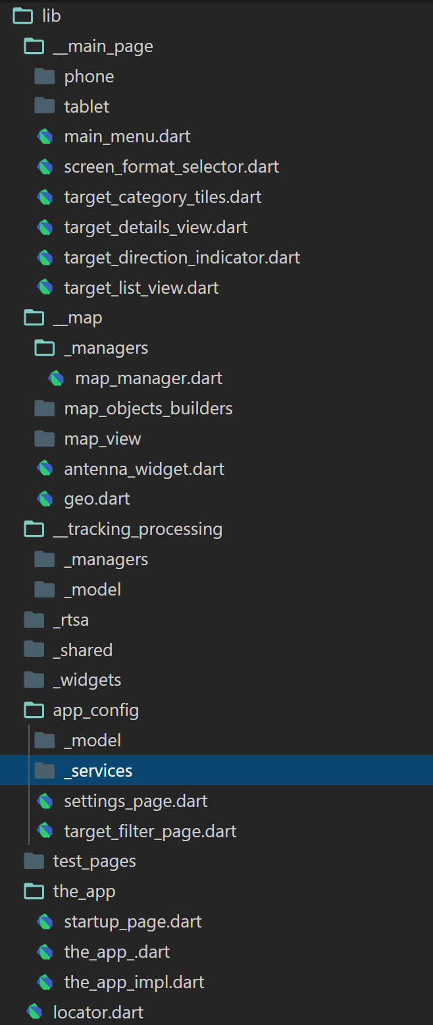
Project structure
main folders are organized by features / bigger function blocks
A feature folder contains all pages, widgets, manager, models and services that are needed by the feature
widgets contain all Widgets that are used on more than one page
locator.dart contains the global instance of the ServiceLocator and all object registrations.

Slide 15
The self responsible Widget
Each widget either gets its needed data passed in the constructor or ‘organizes’ it on their own behalf
decides to which data updates it subscribes or which data it wants to pull
only uses Managers/ Services if data outside its own state has to be used / modified
may read data directly from Services
may read/update data via Managers
don’t implement business logic beyond their semantic context
therefore its logic is easy to understand, to test or debug
Encourages feeling of ownership because you implement all the needed functionality for a Widget/Page
Notes:
3. Example a Page that edits user profiles should not call a function in the InvoiceManage if there is a business necessity to interact then the UserManager should deal with that

Slide 16
Resources
My blog: https://www.burkharts.net/apps/blog/
You can find me on Twitter @ThomasBurkhartsB
And on most chats under ‚escamoteur‘
https://pub.dev/packages/get_it
https://pub.dev/packages/get_it_mixin
https://pub.dev/packages/flutter_command
This presentation and the example project can be found here: https://github.com/escamoteur/RVMS-2020

Slide 17
Questions?

